Slide 1
NCAA Tournament Machine Learning

Slide 2

What is Machine Learning?

Slide 3
Purpose
The purpose of this lunch and learn is for attendees to gain a deeper understanding of what is involved in machine learning
Not how to code
Not which machine learning algorithms are “best”
Not to win NCAA tournament pools

Slide 4


Use Jupyter Notebooks with Python Kernel

Slide 5
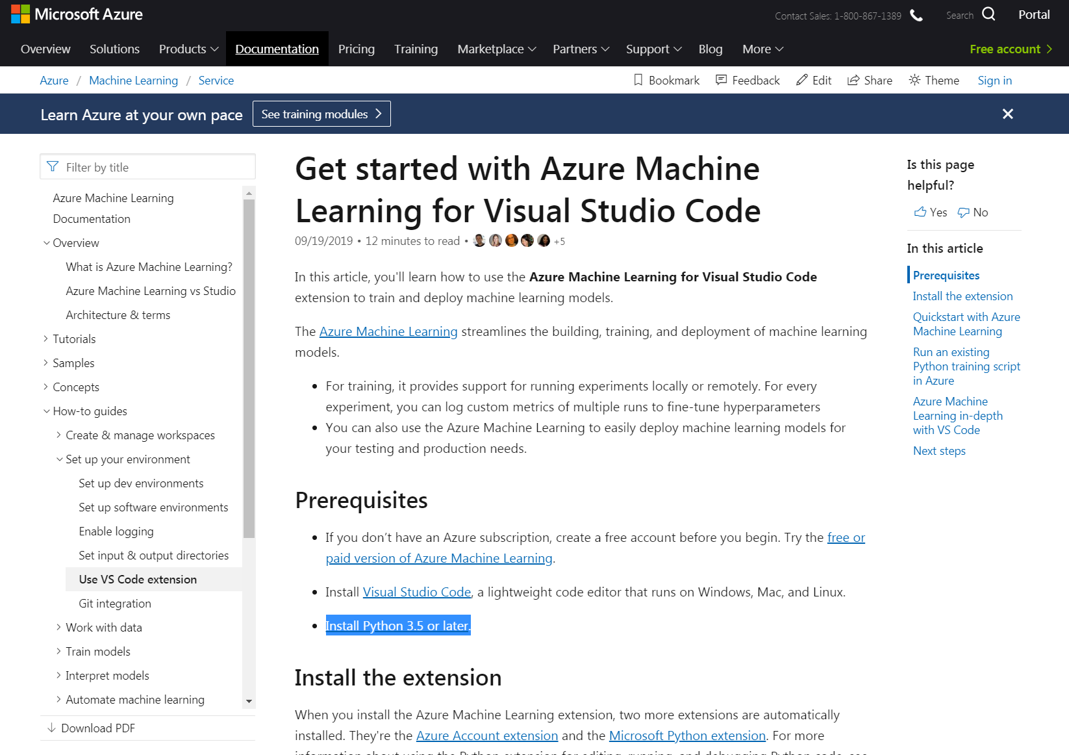
Microsoft’s Machine Learning Tool

Slide 6
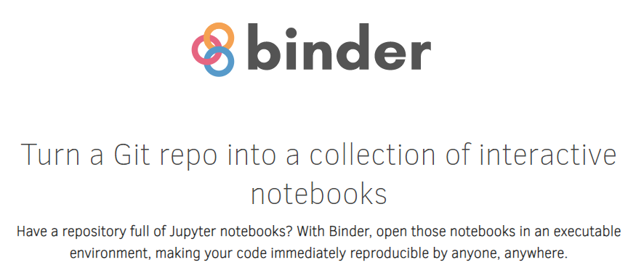
Binder allows running Jupyter Notebooks in the cloud
https://github.com/C176616/March-Madness-2021.git

Slide 7
Quick Disclaimer
This is a difficult problem (especially first problem)
Do not bet money with this bracket. You will lose

Slide 8

Types of Machine Learning
Notes:
We are going to be working in the supervised learning space. This is made up of classification and regression. Classificatoin is if you want to know if something belongs to a category. Say you are coming up with an algorithm to determine the picture is a dog or a cat. Or is it a hot dog?

Slide 9
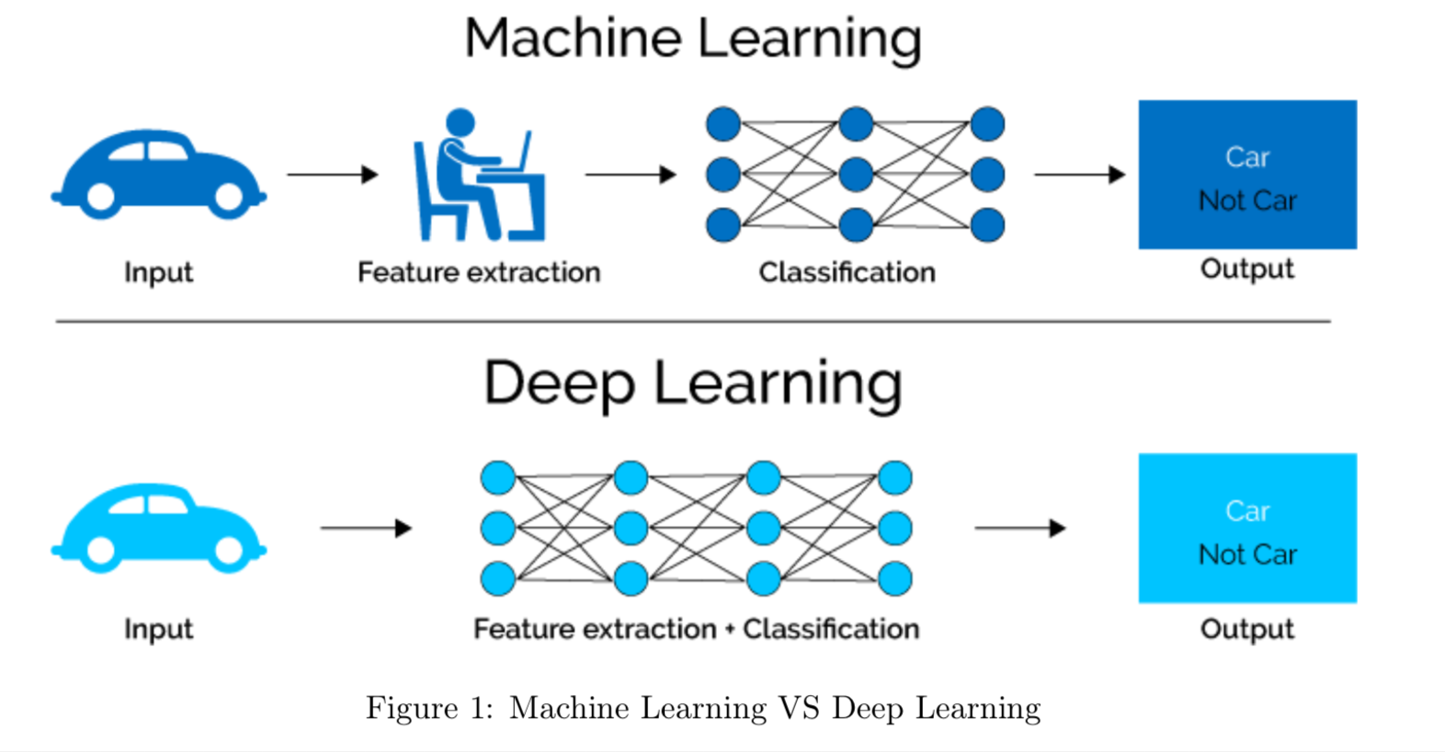
What is Classification?

Slide 10
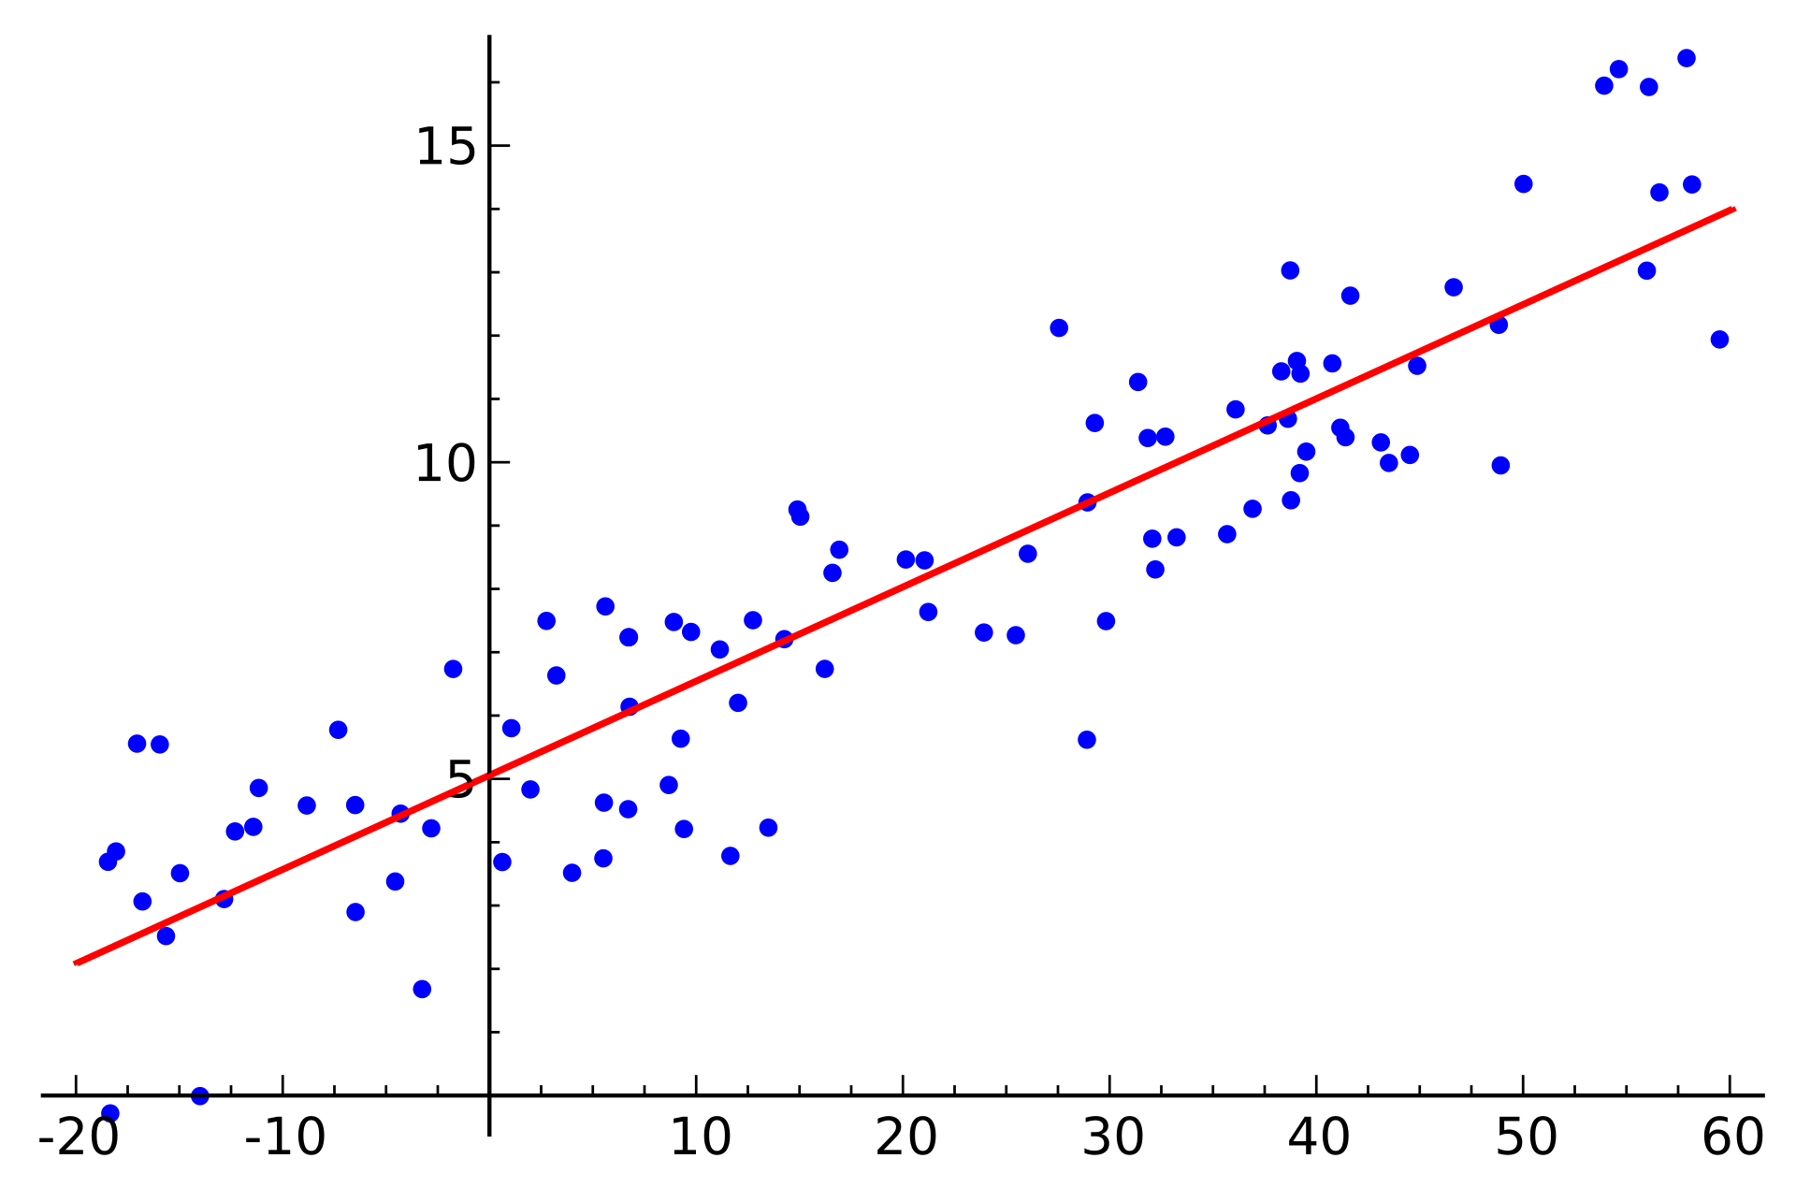
What is Regression?

Slide 11
Back to notebook

Slide 12
Cut to notebook – Part 2
Link here:
https://mybinder.org/v2/gh/thekevster08/MarchMadness/master

Slide 13

We will be using scikit learn

Slide 14


Major Machine Learning Libraries

Slide 15
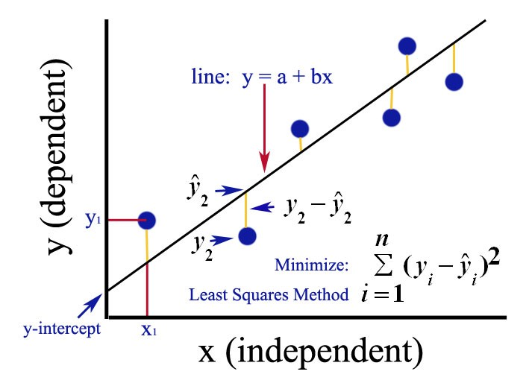
Ordinary Least Squares

Slide 16
Back to notebook

Slide 17
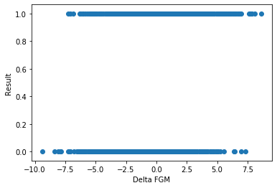
Recall - Categorical Data

Slide 18

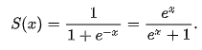
Sigmoid Function

Slide 19
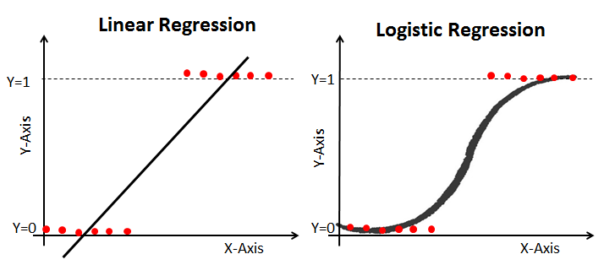
Logistic Regression

Slide 20
Back to notebook

Slide 21
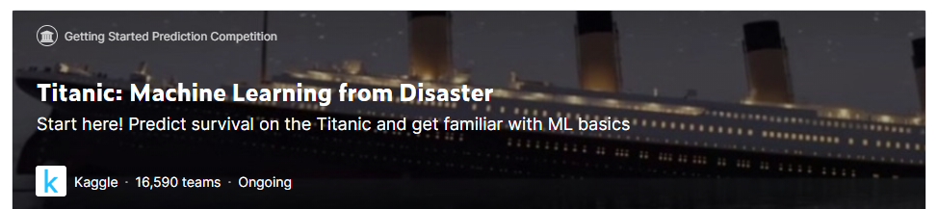
Kaggle – Titanic Challenge

Slide 22
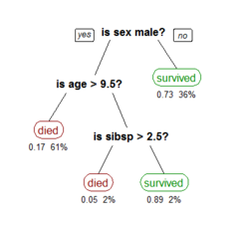
Decision Tree Classifier

Slide 23
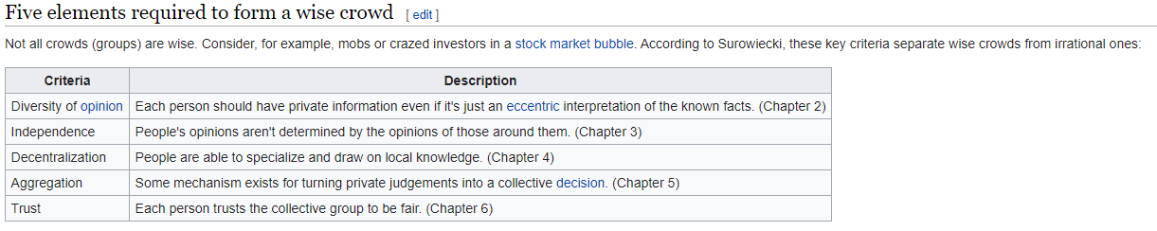
Wisdom of Crowds
Wisdom of crowds is the idea that large groups of people collectively smarter than individual experts when it comes to problem-solving, decision making, innovating and predicting.

Slide 24
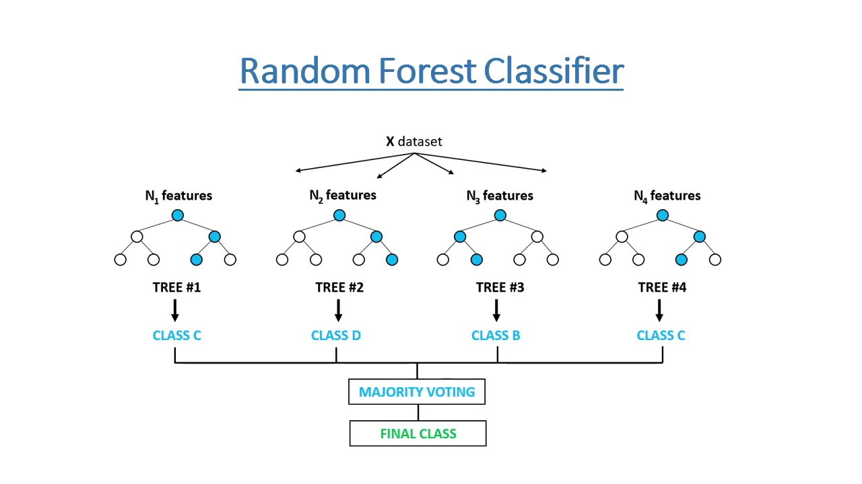
Random Forest Classifier

Slide 25
Back to notebook

Slide 26
What is deep learning?

Slide 27
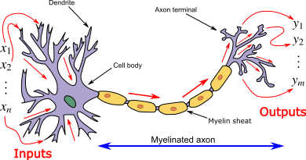
A neural network mimics an actual neuron

Slide 28

Neural Network Architecture

Slide 29
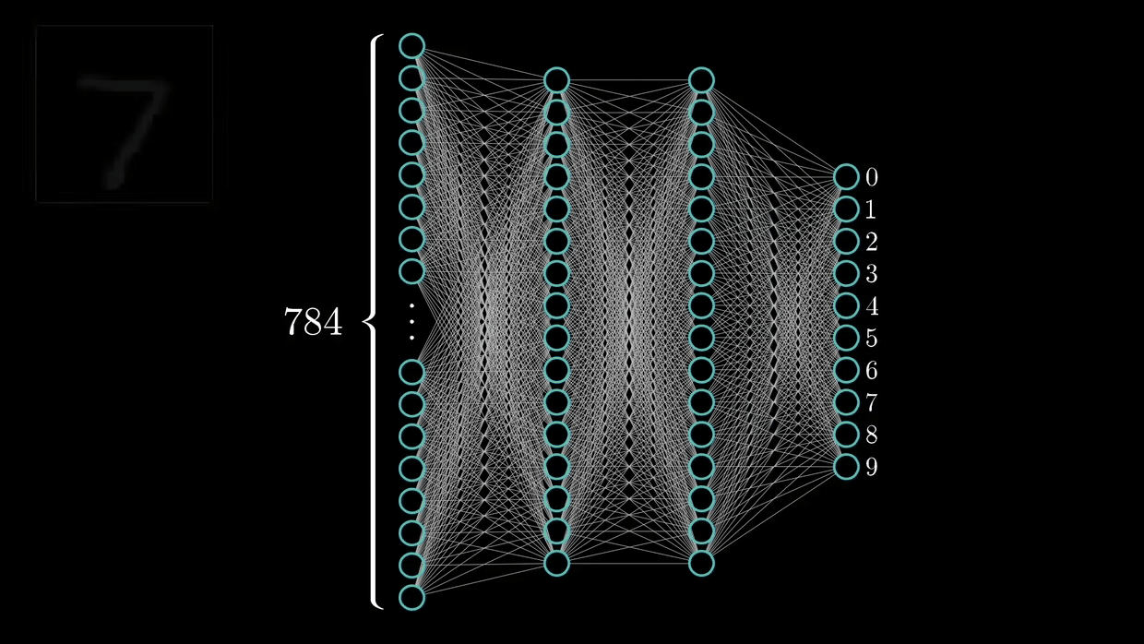
Training a Neural Network

Slide 30
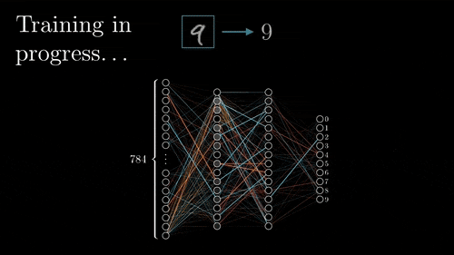
Back Propogation

Slide 31
To notebook

Slide 32
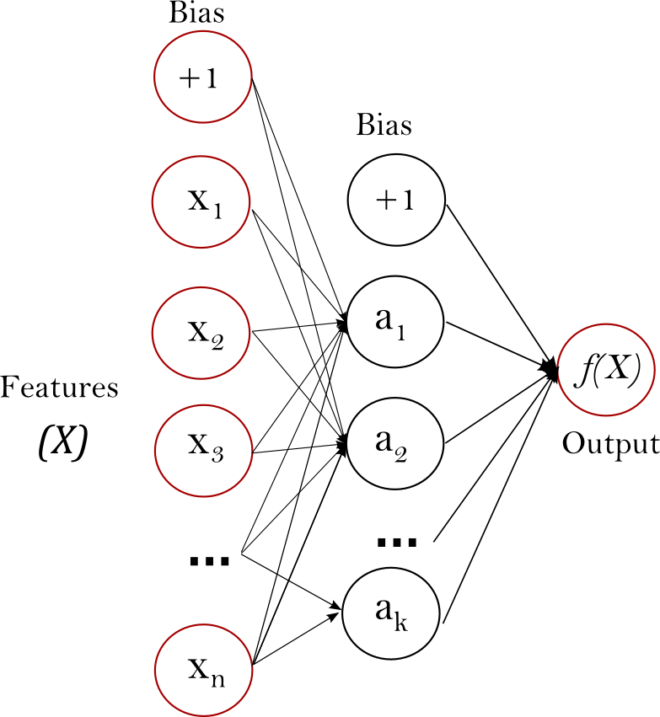
Scale Your Features!

Slide 33
To notebook

Slide 34
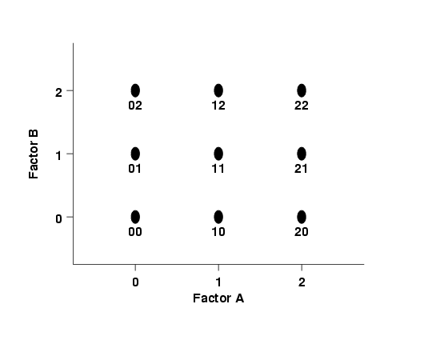
DOE Fundamentals

Slide 35
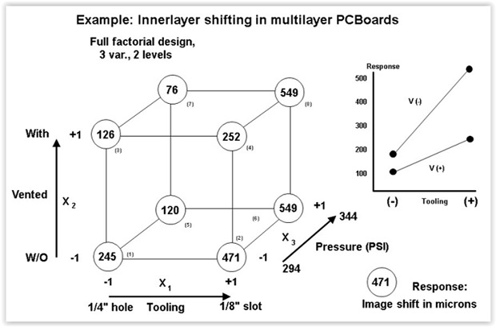
DOE Fundamentals

Slide 36
To Notebook

Slide 37
Source Material
https://github.com/cshaley/bracketeer
https://www.kaggle.com/juliaelliott/basic-starter-kernel-ncaa-men-s-dataset

Slide 38
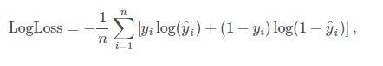
Contest Part 1 – Log Loss of Predictions
ID | Pred
2019_1101_1113 | 0.6
2019_1101_1120 | 0.2
2019_1101_1124 | 0.5
2019_1101_1125 | 0.5
2019_1101_1133 | 0.9
2019_1101_1138 | 0
2019_1101_1153 | 0.1
2019_1101_1159 | 0.7
2019_1101_1181 | 0
2019_1101_1192 | 0.8
2019_1101_1196 | 0.5
2019_1101_1199 | 0.4
2019_1101_1205 | 0.8
2019_1101_1209 | 0.6
2019_1101_1211 | 0
2019_1101_1222 | 0.1
2019_1101_1233 | 0.6
2019_1101_1234 | 0.4
2019_1101_1235 | 0.1
2019_1101_1242 | 0.2
2019_1101_1243 | 0.1
2019_1101_1246 | 0
2019_1101_1251 | 0.5
2019_1101_1257 | 0
n is the number of games played
y^i is the predicted probability of team 1 beating team 2
yi is 1 if team 1 wins, 0 if team 2 wins
log() is the natural (base e) logarithm
*2279 combinations

Slide 39
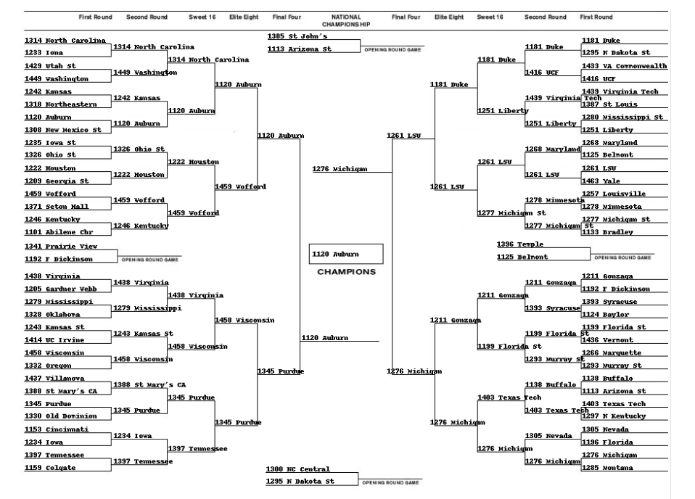
Contest Part 2 – Bracket

Slide 40
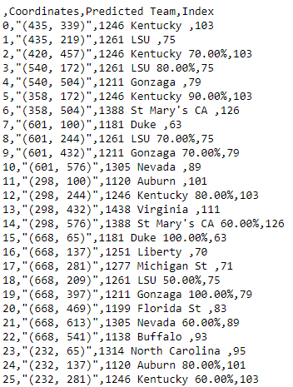
Contest Part 2 – Bracket

Slide 41
Your Submissions:
submission_predictions_part1_FIRSTNAME_LASTNAME
submission_bracket_part2_FIRSTNAME_LASTNAME
Email your submissions to me:
collins_kevin_a@lilly.com
I will email standings periodically.

Slide 42
Conclusion!
Thanks for Attending
Will have again next year, so feedback is welcome!
Visit Kaggle.come to learn more

Slide 43
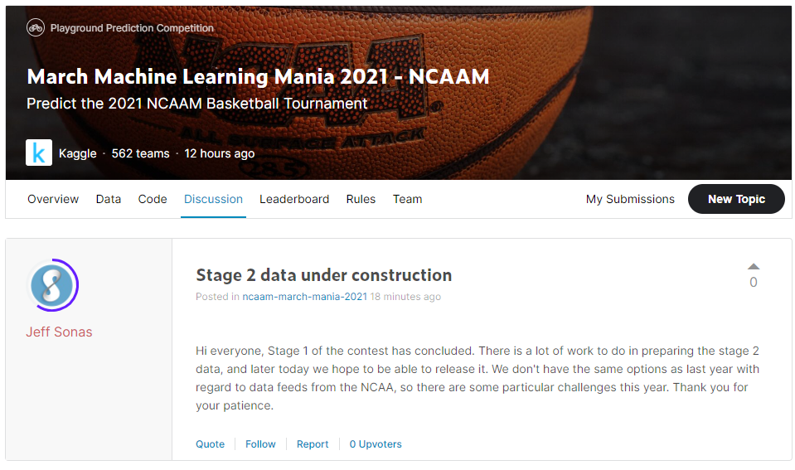
Stage 2 Data Unavailable

Slide 44
Teaser presentation

Slide 45
Explore Several Types of Models
Neural Network
Random Forest Classifier
Linear Regression
Logistic Regression
Decision Tree Classifier

Slide 46
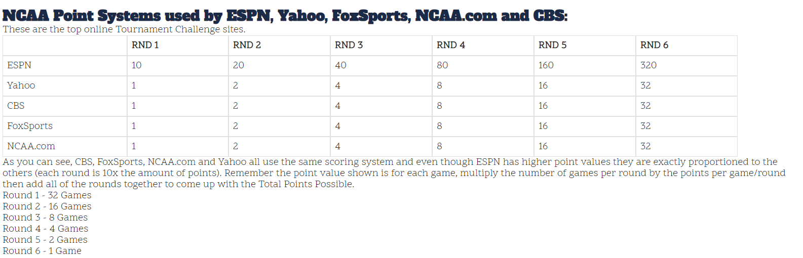
Contest Part 2 – Bracket

Slide 47
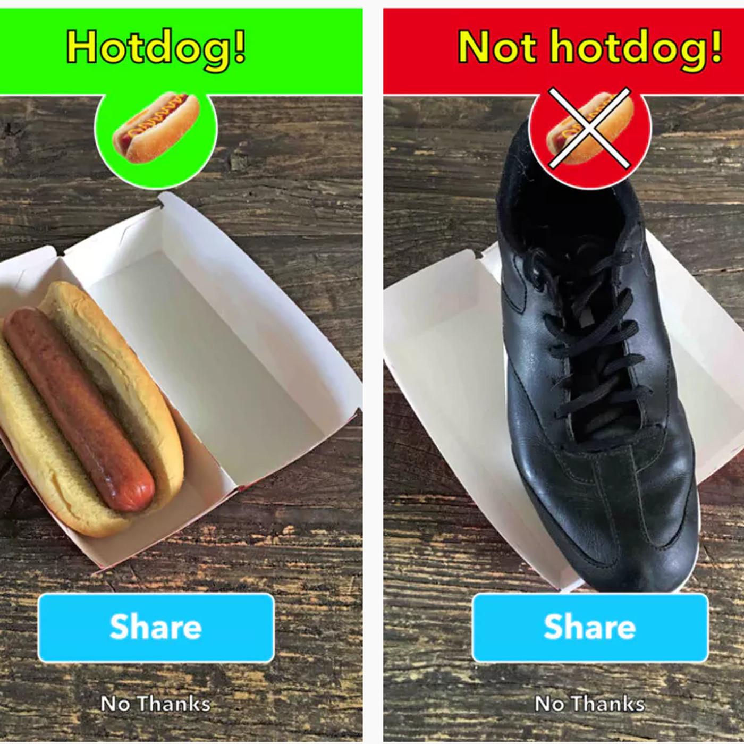

Example of Classification

Slide 48

isthisacat.com

Slide 49

Questions?

Slide 50
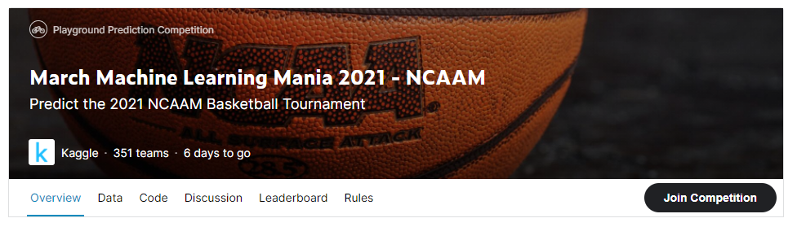
Official Competition

Slide 51
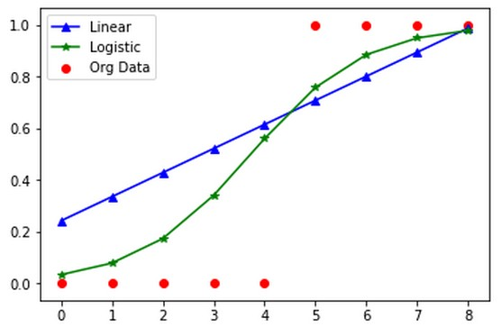

Slide 52
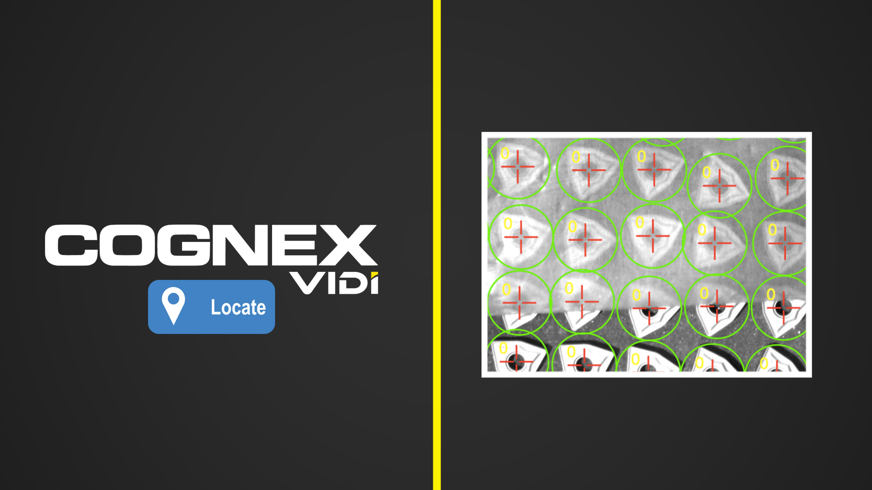
Cognex Vidi
Cognex Uses ViDi, Proprietary Deep Learning software

Slide 53
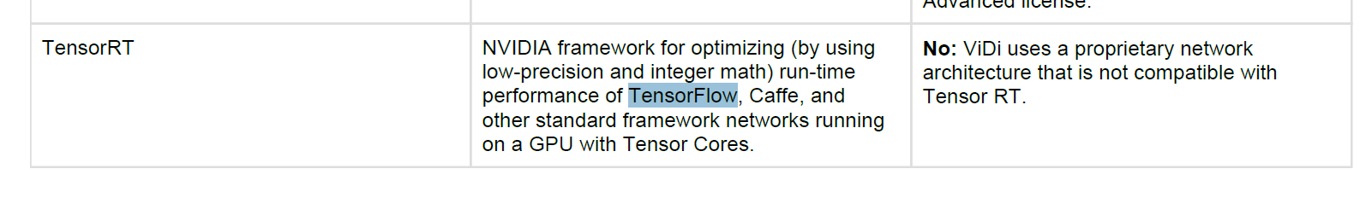
Cognex Vidi
ViDi’s “proprietary” algorithm is based on TensorFlow

